Slide 1
Scaling Up Summer Bridge Programs Program Assessment
Karen McLeer Executive Director of Retention and Academic Support UW-Platteville

Slide 2
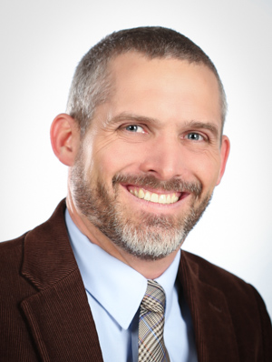
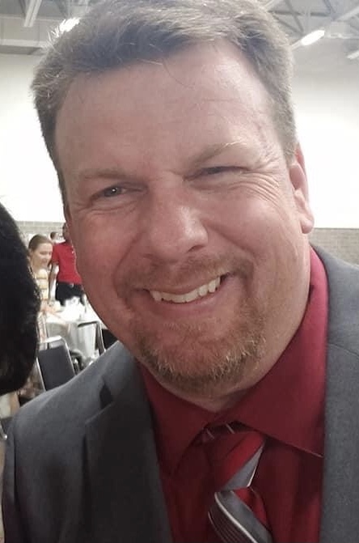
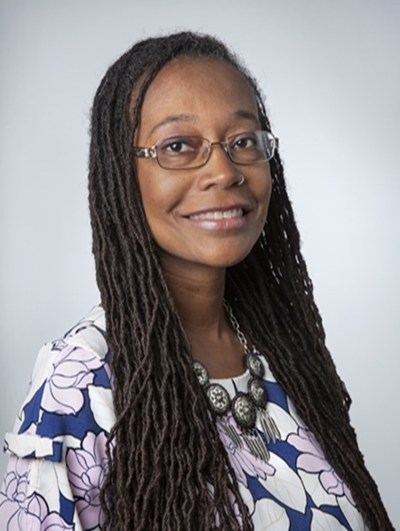
Panel Members
Vincent Lowery Director of Student Success and Engagement UW-Green Bay
J.J. Andrews Assessment Specialist & Data Steward UW-Madison
Ozalle Toms Assistant Vice Chancellor for Student Diversity, Engagement, and Success UW-Whitewater

Slide 3

Session Objectives
Identify common objectives for bridge programs;
Describe various methods for collecting data;
Plan how to use data to take action.

Slide 4
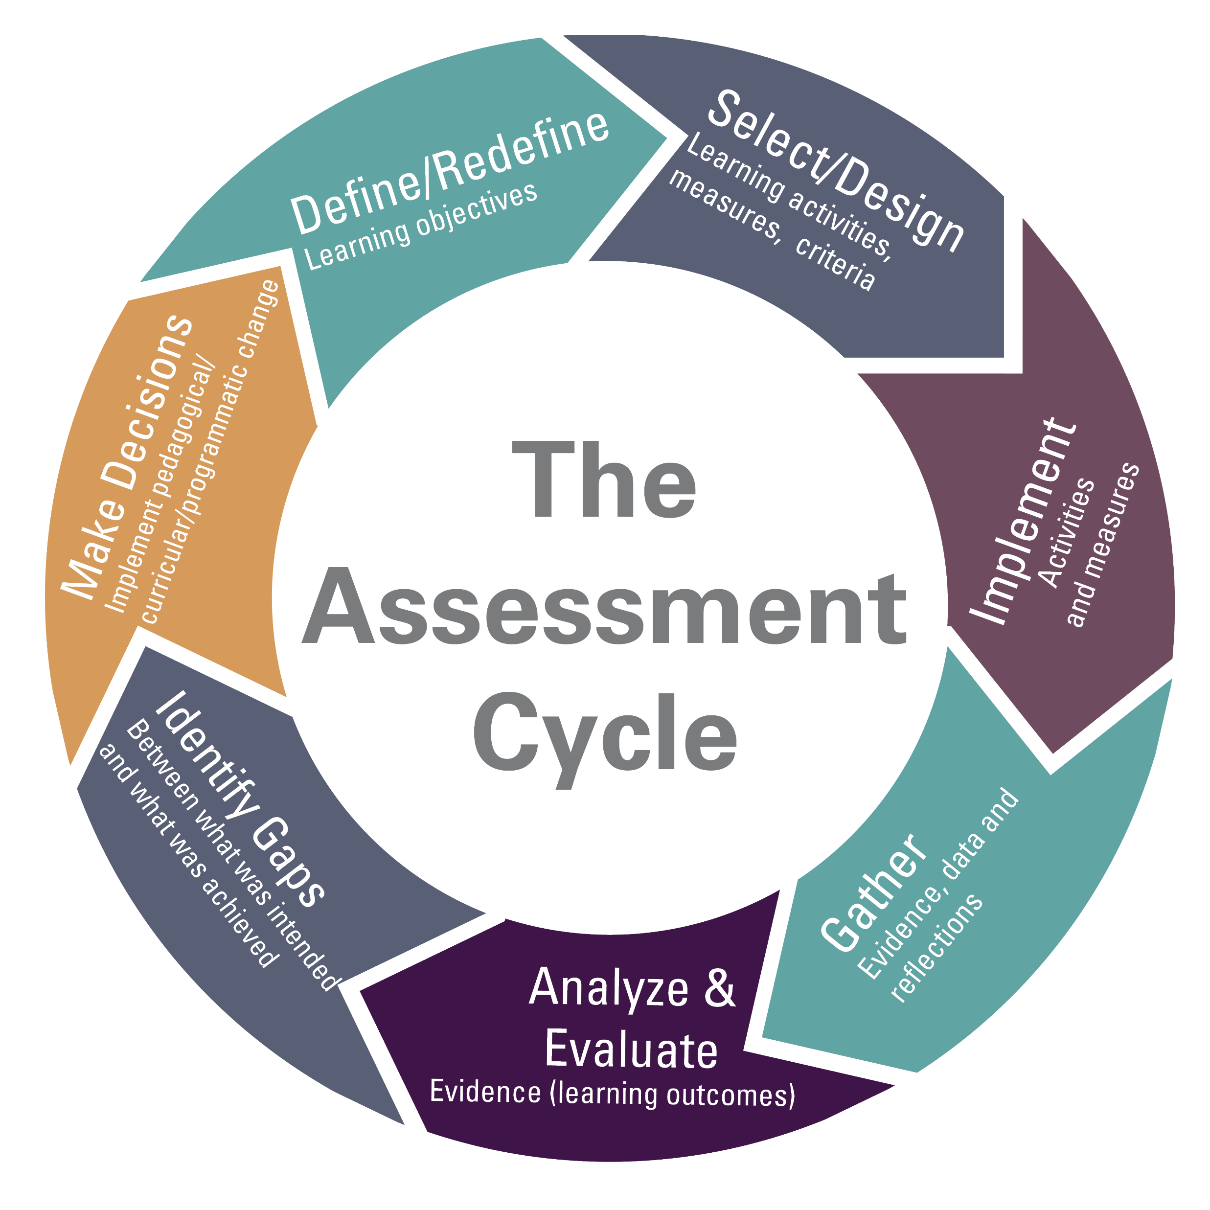
Why Assess?

Slide 5

What do we assess?
Needs
Utilization of services
Satisfaction
Learning
Start with the end in mind
Focus on what we want the students to experience/learn

Slide 6

Panelist Questions
What are the objectives for your bridge program?
How did you select them?

Slide 7

Collecting Data
Surveys are just one of many ways to gather information
Surveys
Tracking Metrics
Interviews
Focus Groups
Analyzing documents/artifacts
Notes:
SLIDE SPEAKER: Vitaliano
*Mention challenge and discuss how the campus pivoted to address the challenge and turned it into a positive outcome
Talking Points:
Impact on students and staff: provide some examples of how campuses are promoting self care and wellness tips to manage the virtual environment
Access to technology: what are some campuses doing to make sure technology is being provided to students in hybrid or online formats
How important video conferences capabilities were when it came to tele health and tele counseling
Campus communications: external communications, hotlines, newsletters, etc.
More communications across units – UW-Milwaukee example of Pathways & Interventions
Space: how has existing space been converted to support testing or classrooms
Budgetary impacts: impact of seg fees and furloughs on student affairs

Slide 8
Panelist Questions
What data collection methods have you found to be most effective?
Any that you want to caution against?

Slide 9

Closing the Loop
Analyzing and Reporting Assessment Results
Taking Action Based on Assessment

Slide 10
Panelist Questions
What do you do with your assessment data?
How does it help you serve students, develop programming, or revise future bridge programs?

